Slide 1
Chapter 17: Data Link Control: Line configurations, Flow Control and Error Control techniques - Sliding Window, Stop and wait ARQ

Slide 2
Introduction
The most important responsibilities of the data link layer are flow control and error control. Collectively, these functions are known as data link control.
Flow control refers to a set of procedures used to restrict the amount of data that the sender can send before waiting for acknowledgment.
Flow control is needed since the sending entity should not overwhelm the receiving entity
    Recipient needs some time to process incoming packets
    If sender sends faster than recipient processes, then buffer overflow occurs
      Flow control prevents buffer overflow

Slide 3
Approaches
Two approaches:
  Feedback-based flow control
  Rate-based flow control
Feedback-based Flow Control
Receiver sends back information to the sender giving it permission to send more data, or Telling sender how receiver is doing.
Rate-based Flow Control
Built in mechanism that limits the rate at which sender may transmit data, without the need for feedback from the receiver.

Slide 4
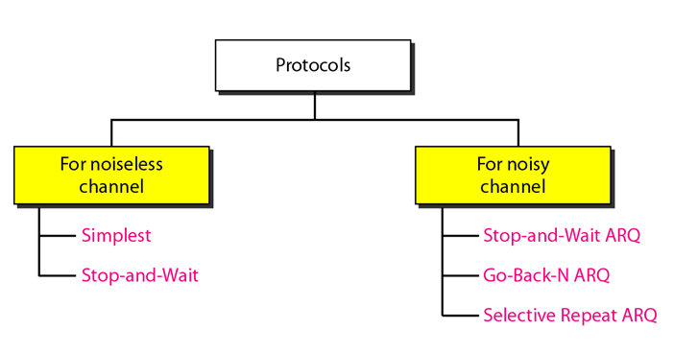
Protocols
The data link layer combines framing, flow control, and error control to achieve the delivery of data from one node to another. The protocols are normally implemented in software by using one of the common programming languages.

Slide 5
Noiseless Channels
Let us first assume we have an ideal channel in which no frames are lost, duplicated, or corrupted. We introduce two protocols for this type of channel.
Simplest Protocol:
It does not worry about the possibility of anything going wrong.
Data are transmitted in one direction only.
Both the transmitting and receiving network layers are always ready.
Processing time can be ignored.
Infinite buffer space is available.
And best of all, the communication channel between the data link layers never damages or loses frames.
This thoroughly unrealistic protocol, is called ‘‘Utopia’’.

Slide 6
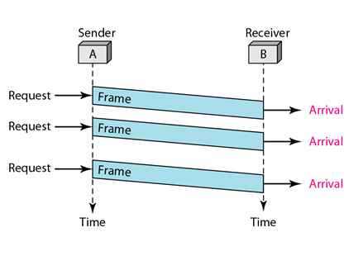
Simplest Protocol
Figure below shows an example of communication using this protocol. To send three frames, three events occur at the sender site and three events at the receiver site. Note that the data frames are shown by tilted boxes; the height of the box defines the transmission time difference between the first bit and the last bit in the frame.

Slide 7
Stop and Wait Flow Control
Protocols in which the sender sends one frame and then waits for an acknowledgement before proceeding are called stop-and-wait.
Source transmits frame
Destination receives frame and replies with acknowledgement (ACK)
Source waits for ACK before sending next frame
Destination can stop flow by not sending ACK
Although data traffic in this example is simplex, going only from the sender to the receiver, frames do travel in both directions.

Slide 8
Stop and Wait Flow Control-Cont.
Consequently, the communication channel between the two data link layers needs to be capable of bidirectional information transfer.
However, this protocol entails a strict alternation of flow: first the sender sends a frame, then the receiver sends a frame, then the sender sends another frame, then the receiver sends another one, and so on.
A half-duplex physical channel would suffice here.

Slide 9
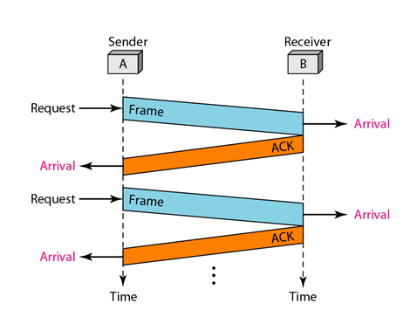
Stop and Wait Flow Control-Cont.
Figure below shows an example of communication using this protocol. It is still very simple. The sender sends one frame and waits for feedback from the receiver. When the ACK arrives, the sender sends the next frame. Note that sending two frames in the protocol involves the sender in four events and the receiver in two events.

Slide 10
Go-Back-N ARQ
Allows multiple frames to be sent before waiting for ACK
These frames must be numbered differently
Frame numbers are called Sequence numbers
Frames must be received in the correct order
If a frame is lost, the lost frame and all of the following frames must be retransmitted

Slide 11
Sequence Number
Frames from a sending station are numbered sequentially.
However, because we need to include the sequence number of each frame in the header, we need to set a limit.
If the header of the frame allows m bits for the sequence number, the sequence numbers range from 0 to 2^{m} - 1.
For example, if m is 4, the only sequence numbers are 0 through 15 inclusive.
However, we can repeat the sequence. So the sequence numbers are
0, 1,2,3,4,5,6, 7,8,9, 10, 11, 12, 13, 14, 15,0, 1,2,3,4,5,6,7,8,9,10, 11, …

Slide 12
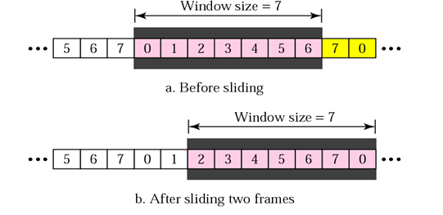
Sender Sliding Window
At the sender site, to hold the outstanding frames until they are acknowledged, we use the concept of a window.
We imagine that all frames are stored in a buffer.
The outstanding frames are enclosed in a window.
The frames to the left of the window are those that have already been acknowledged and can be purged.
The frames to the right of the window cannot be sent until the window slides over them.

Slide 13
Sender Sliding Window-Cont.
For m-bit sequence numbers, send window size: at most 2^{m}-1
Up to 2^{m}-1 frames can be sent without ACK
The size of the window in this protocol is fixed, although we can have a variable size window in other protocols such as TCP.
The window slides to include new unsent frames when the correct acknowledgements are received.
The window is a sliding window.

Slide 14
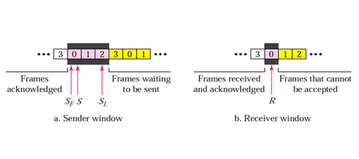
Control Variable
The S variable holds the sequence number of the recently sent frame.
S_{F} holds the sequence number of the first frame in the window.
S_{L} holds the sequence number of the last frame in the window.
The receiver only has one variable R that holds the sequence number of the frame it expects to receive.

Slide 15
Timer
The sender sets a timer for each frame sent
The receiver has no timers.

Slide 16
Acknowledgement
The receiver sends a positive acknowledgment if a frame has arrived safe and sound and in order.
If a frame is damaged or is received out of order, the receiver is silent and will discard all subsequent frames until it receives the one it is expecting.
The silence of the receiver causes the timer of the unacknowledged frame at the sender site to expire.
This, in turn, causes the sender to go back and resend all frames, beginning with the one with the expired timer.
The receiver does not have to acknowledge each frame received. It can send one cumulative acknowledgment for several frames.

Slide 17
Resending a frame
When the timer expires, the sender resends all outstanding frames. For example, suppose the sender has already sent frame 6, but the timer for frame 3 expires. This means that frame 3 has not been acknowledged; the sender goes back and sends frames 3, 4, 5, and 6 again. That is why the protocol is called Go-Back-N ARQ.

Slide 18
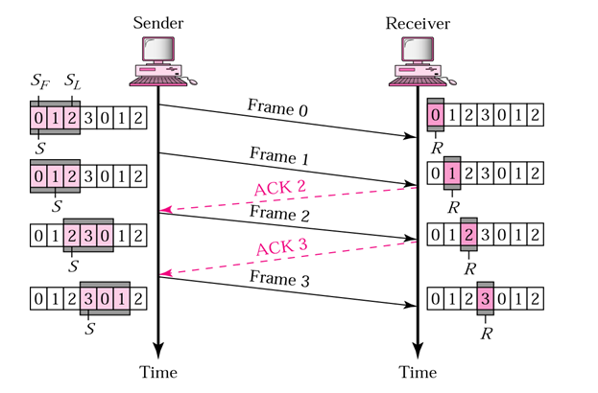
Normal Operation

Slide 19
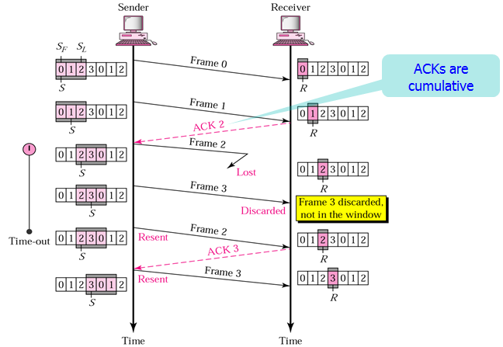
Damaged or Lost Frame

Slide 20
Damaged or Lost Acknowledgement
If the acknowledgement is damaged or lost, we can have two situations.
If the next acknowledgement arrives before the expiration of any timer, there is no need for retransmission of frames because acknowledgements are cumulative in this protocol.
ACK 4 means ACK 1 to ACK 4. So if ACK 1, ACK2, ACK3 are lost, ACK 4 covers them.
However if the next ACK arrives after the time-out, the frame and all the frames after that are resent.
Delayed Acknowledgement
A delayed acknowledgement also triggers the resending of frames.

Slide 21
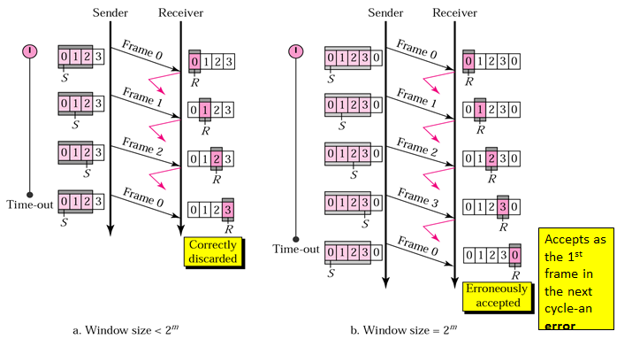
Go-Back-N Sender window size
Size of the sender window must be less than 2 ^{m}. Size of the receiver is always 1. If m = 2, window size = 2 ^{m} – 1 = 3.
Fig compares a window size of 3 and 4.

Slide 22
Go-Back-N Sender window size
If the size of the window is 3 (less than 2²) and all three acknowledgments are lost, the frame 0 timer expires and all three frames are resent. The receiver then expects frame 3, not frame 0, so the duplicate frame is correctly discarded. On the other hand, if the size of the window is 4 (equal to 2²) and all acknowledgments are lost, the sender will send a duplicate of frame 0. However, is case of window size 4, the window of the receiver expects to receive frame 0, so it accepts frame 0, not as a duplicate, but as the first frame in the next cycle, which is an error.

Slide 23
Go-Back-N Performance
Go-Back-N ARQ is a more efficient use of a connection than Stop-and-wait ARQ, since unlike waiting for an acknowledgement for each packet; the connection is still being utilized as packets are being sent. In other words, during the time that would otherwise be spent waiting, more packets are being sent. However, this method also results in sending frames multiple times – if any frame was lost or damaged, or the ACK acknowledging them was lost or damaged, then that frame and all following frames in the window (even if they were received without error) will be re-sent. To avoid this, Selective Repeat ARQ can be used.

Slide 24
Problem
For a system using Go-Back-N, explain why the size of the sender and receiver windows must be less than 2 ^{m}, where m is the number of bits for the sequence number.
Problem
Draw the sender and receiver windows for a system using Go-Back-N ARQ, given the following: Frame 0 is sent; frame 0 is acknowledged. Frames 1 and 2 are sent; frames 1 and 2 are acknowledged. Frames 3, 4 and 5 are sent; frame 4 is acknowledged; timer for frame 5 expires. Frames 5, 6 and 7 are sent; frames 4 through 7 are acknowledged

Slide 25
Problem
Explain how lost or damaged frame is handled in Go-back-N ARQ.
(You have to describe the figure in your own word)

